Slide 1
Visualizations using
Matplotlib and Seaborn
By – Rageeni Sah
sahrageeni4@gmail.com

Slide 2
Introduction
When to comes to data visualization selecting a graph which will represent data in efficient way is crucial
There are abundant graphs type, but all may not fit for your data
Few supports python libraries & packages for data visualization are matplotlib, seaborn, plotly, etc.
However, crucial question remains – which graph to use?

Slide 3
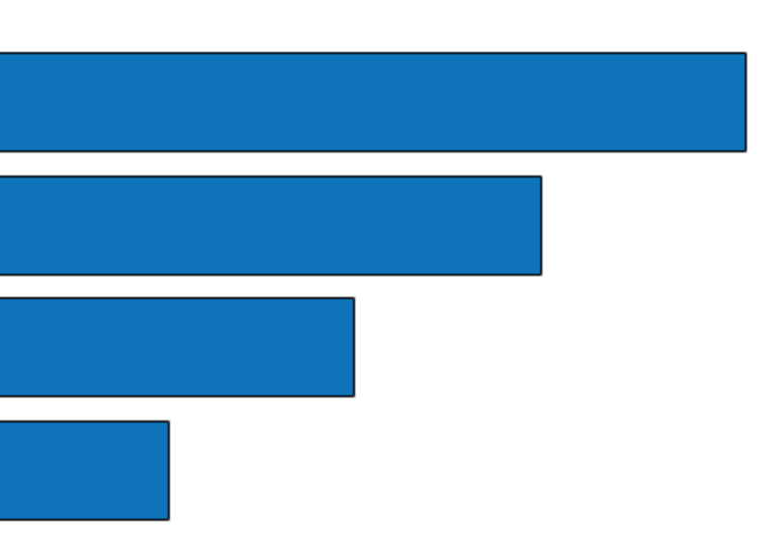
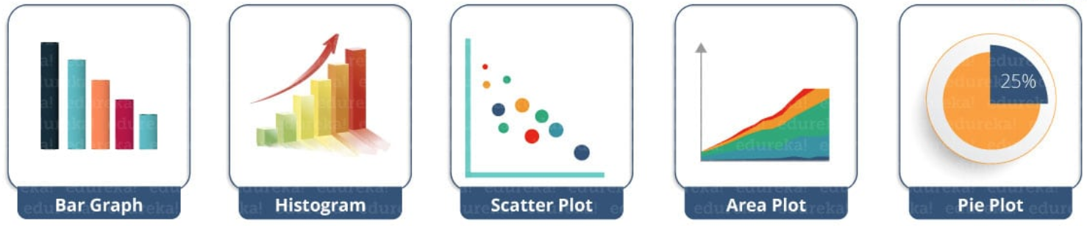
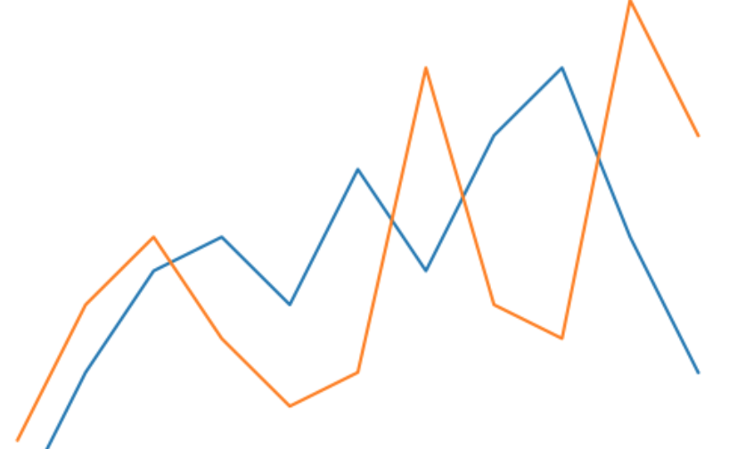
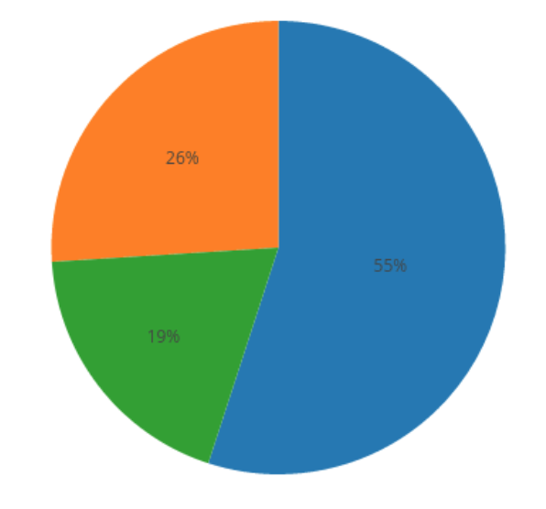
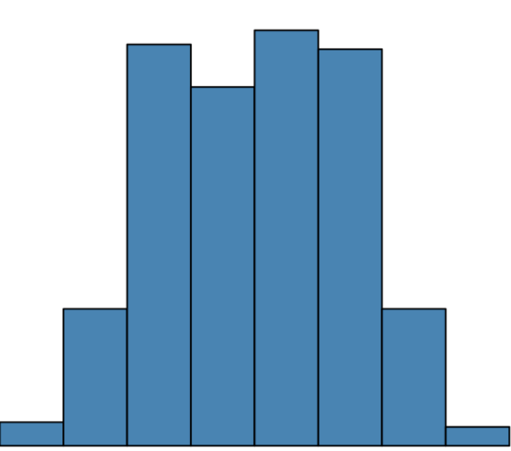
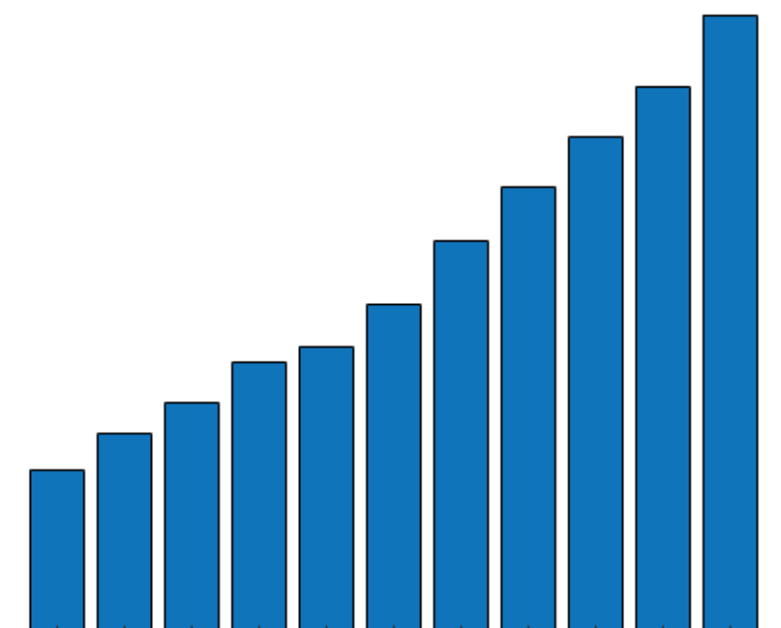
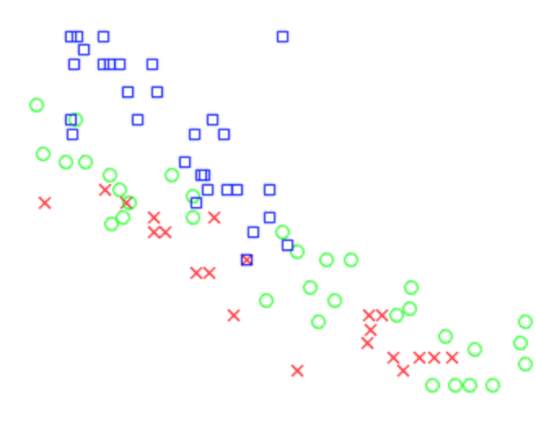
Which graph?

Slide 4
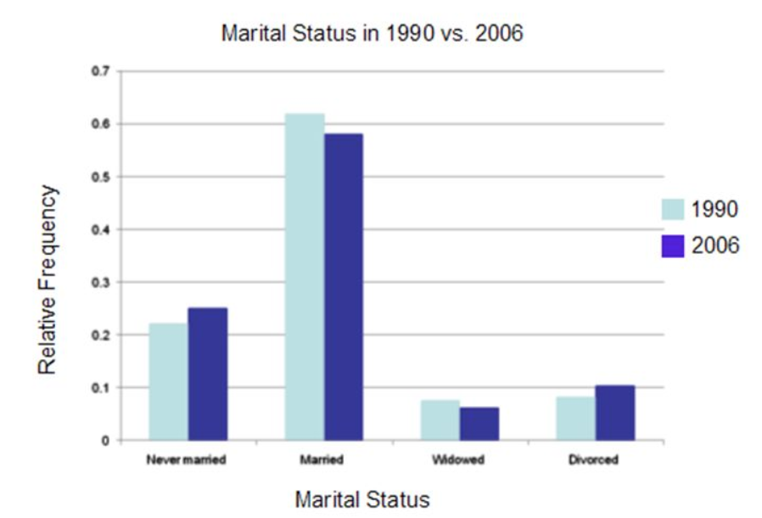
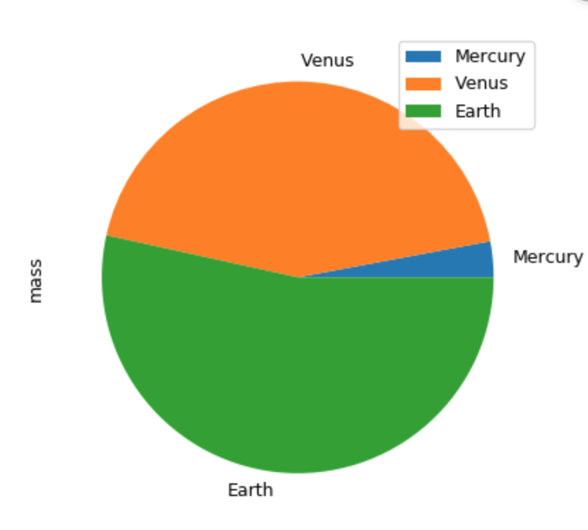
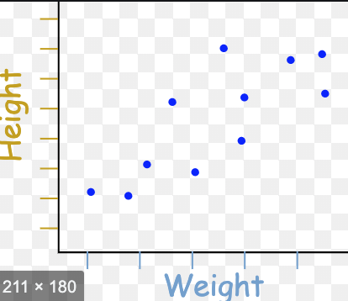
Guidelines
Graph | When to use? | Examples
Bar – plot | Categories comparison Suitable for fewer categories
Pie plot | Represent portions of a whole entity
Scatter plot | To visualize change in one variable w.r.t. another variable

Slide 5
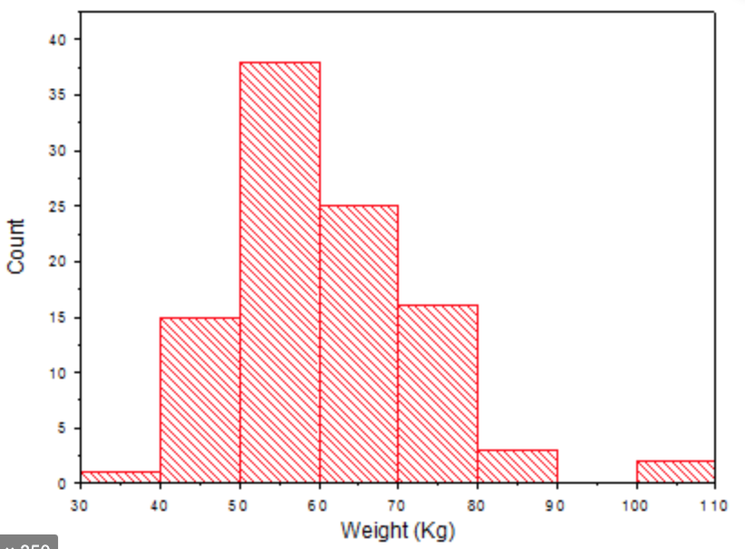
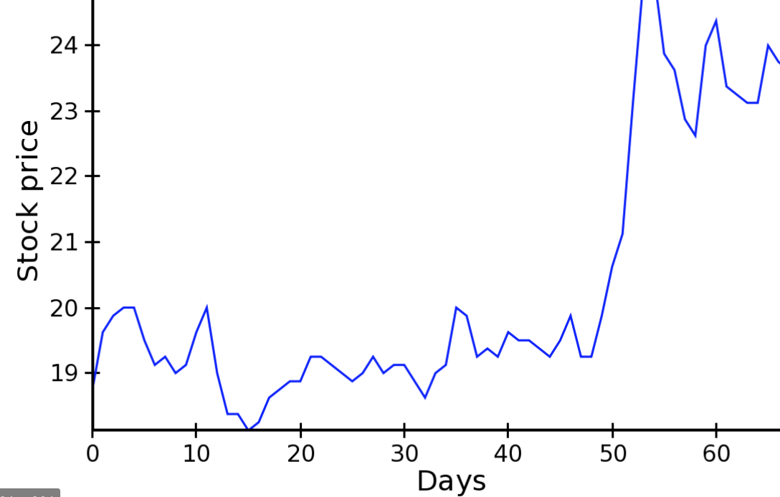
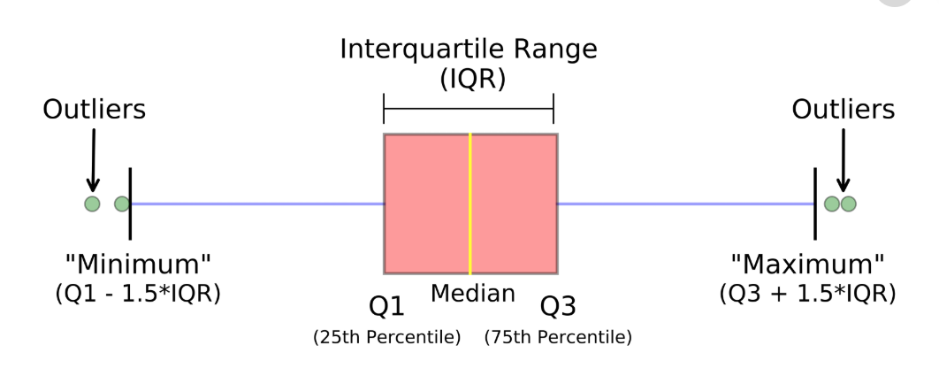
Guidelines
Graph | When to use? | Examples
Histogram | Categories frequency for given interval
Line plot | Distribution over time period
Boxplot | Statistical summary of the data

Slide 6
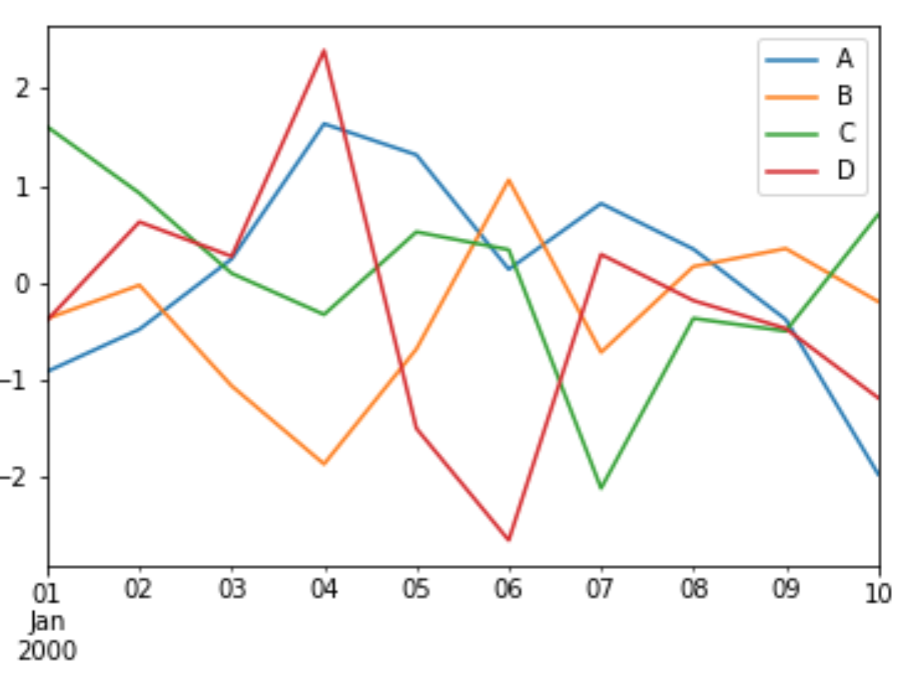
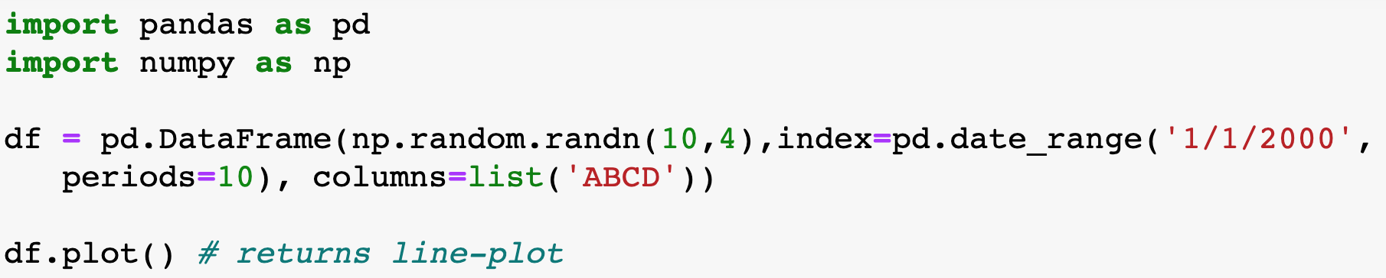
Pandas - visualisation

Slide 7
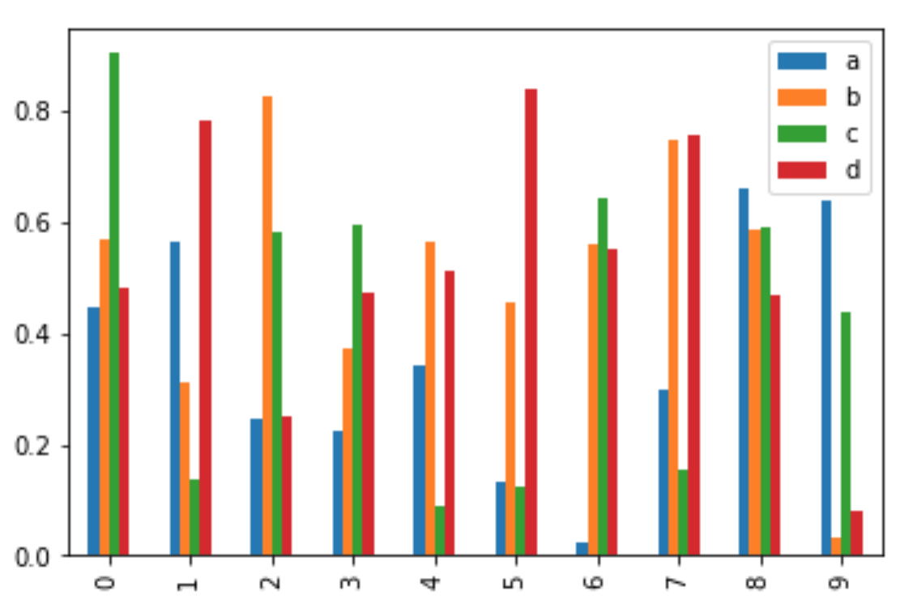
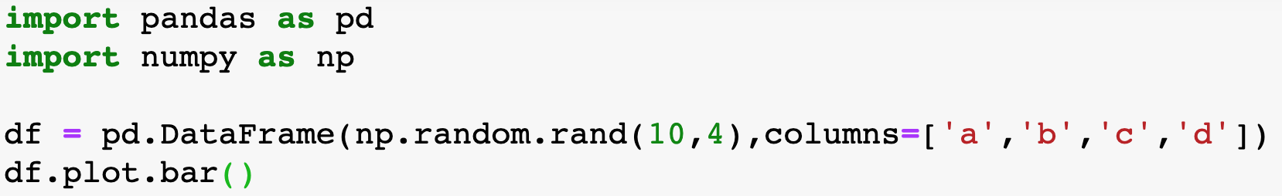
Pandas – visualization bar plot

Slide 8
Matplotlib – visualization
Function | Graph | Description
plt.plot(x,y) | Line plot | Plots y vs x; x, y can be series or dataframe columns
plt.scatter(x,y) | Scatter plot | A scatter plot of *y* vs *x* with varying marker size and/or color
plt.bar(x) | Bar plot | Make a bar plot
plt.boxplot(x) | Box plot | Make a box and whisker plot
plt.hist(x) | Histogram | Plot a histogram
matplotlib.pyplot is a plotting library used for 2D graphics in python programming language.
Various plots can be created using matplotlib
Import package:
  import matplotlib.pyplot as plt

Slide 9
Seaborn – visualization
Function | Graph | Description
sns.heatmape(data) | Heatmap | Plot rectangular data as a color-encoded matrix
sns.countplot() | Count plot | Show the counts of observations in each categorical bin using bars
sns.boxplot() | Boxplot | Draw a box plot to show distributions with respect to categories
sns.swarmplot() | Swarm plot | Draw a categorical scatterplot with non-overlapping points
sns.pairplot(data) | Pairplot | Plot pairwise relationships in a dataset
sns.distplot(x) | Distplot | Flexibly plot a univariate distribution of observations
Seaborn is an open source library providing high level API for visualizing the data using Python programming language
Import package to use
  import seaborn as sns

